Slide 2
Parameters for Rating Municipal Councillors (1/4)
Parameter | Marks
Present¹(Attendance, No. & Quality of Issues Raised, Usage of Area Development Fund) | 63
Past ²(Education qualification, PAN Card, Criminal cases) | 7
Perception (through an citizen survey of 29,950 people for their perception on their Councillor’s accessibility/availability, performance, corruption, and satisfaction with quality of life, services provided by government) | 30
Negative for new FIR cases after 2012 election ³ | Minus 5
Negative for pending Charge Sheet ³ | Minus 5
Total | 100
Period under consideration – April 2015 to March 2016
RTI Data Source: ¹ Municipal Secretary, MCD and Engineering (Planning) & Accounts Department ; ² MCD and Election Commission of India’s Website; ³ Delhi Police.

Slide 3
Parameters for Rating Municipal Councillors (2/4)
Present Parameter (Marks)
Sessions Attended Based on percentage of attendance. 1) 100% to 91%- 10; 2) 90% to 76% - 8; 3) 75% to 61% -6; 4) 60% to 51% - 4; and 5) below 50% - 0 | 15
Number of Issues Raised Against Group Percentage Rank. 10 being the top most percentile and so on to the lowest for 0 | 10
Importance of Issues Raised Based on issues raised asked related to Obligatory duties , Discretionary duties as per the Delhi Corporation Act, 1957 or based on subjects under the power of State/Central governments. | 23
Issues raised compared to Citizen's Complaints Based on issues raised by councillors compared with complaints of citizens as collated by the 12 zonal control rooms. | 10
Total Local Area Development Funds Utilised during April’2015 to March'2016 Calculation for the current financial year is done for the utilised (booked) fund of Rs.50 lakh for NDMC, Rs.30 lakh for SDMC & Rs.25 lakh for EDMC.1) 100% (or more) to 91%- 5; 2) 90% to 76% - 4; 3) 75% to 61% -3; 4) 60% to 51% - 2; and 5) below 50% - 0 | 5
Back

Slide 4
Parameters for Rating Municipal Councillors (3/4)
Past Parameter (Marks)
Education Qualification A minimum of 10th Pass - 1; if not – 0 | 1
Income Tax 1) Possessing PAN Card - 1 | 1
Criminal Record If the candidate has zero cases registered against her/him, then 5; else as below: 1) Criminal Cases Registered containing the following charges: Murder, Rape, Molestation, Riot, Extortion - 0 2) Other criminal cases than the above mentioned – 3 | 5
Back

Slide 5
Parameters for Rating Municipal Councillors (4/4)
Perception Parameter (Marks)
Perception of Public Services Score on Public Services | 11
Awareness & Accessibility Score on Awareness amongst people about their representative, their political party and ease of access to the representative | 5
Corruption Index Score on perceived personal corruption of the representative | 7
Broad Measures Score on overall satisfaction and improvement in quality of life | 7
Back
Notes:
!) The weightage for Perception of Public Services was further divided into a hierarchy of 4 levels to meet the desired objective. Level 1 included facilities which are more critical to state government whereas Level 4 included facilities that are more critical to central government.
Level 1 – This level included areas like Power supply, Law & Order situation & Instances of crime. It was given a weightage of 8 points
Level 2 – This level included areas like Availability of food through ration shops & Pollution problems. It was given a weightage of 5 points
Level 3 – This level included areas like Hospitals & other Medical facilities & Appropriate Schools & Colleges. It was given a weightage of 4 points
Level 4 – This level included rest of the areas like Condition of Roads, Traffic Jams & Congestion, Availability of public gardens, Availability of public transport facilities, Water Supply, Water logging problems & Cleanliness & Sanitation facilities. It was given a weightage of 3 points
2) Broad Overall Measures: included opinions on Satisfaction with the MLA and Improvement in Lifestyle.

Slide 7
Top 3 Municipal Councillors
NDMC
Councillors Name | Area | Constituency No. | Political Party | Score (out of 100) | Overall Rank
Seema Taihra | Bazar Sita Ram | 83 | INC | 69.78 | 1
Rakesh Kumar | Kucha Pandit | 82 | BSP | 68.59 | 2
Lata Sodhi | Ram Nagar | 87 | BJP | 67.59 | 3
SDMC
Councillors Name | Area | Constituency No. | Political Party | Score (out of 100) | Overall Rank
Rajni Mamtani | Janak Puri South | 118 | BJP | 72.41 | 1
Simmi Jain | Darya Ganj | 153 | BJP | 69.46 | 2
Radhey Shyam Sharma | Vasant Vihar | 165 | BJP | 67.86 | 3
EDMC
Councillors Name | Area | Constituency No. | Political Party | Score (out of 100) | Overall Rank
Varyam Kaur | Raghubarpura | 236 | INC | 67.60 | 1
Anil Gautam | Durga Puri | 245 | INC | 66.34 | 2
Ratan Singh | Vishwas Nagar | 226 | INC | 66.12 | 3

Slide 8
Bottom 3 Municipal Councillors
NDMC
Councillors Name | Area | Constituency No. | Political Party | Score (out of 100) | Overall Rank
Manisha Jasbir Karala | Karala | 29 | INC | 32.17 | 99
Reeta | Bakhtawarpur | 4 | BSP | 32.67 | 98
Reeta Shokeen | Nilothi | 32 | IND | 32.78 | 97
SDMC
Councillors Name | Area | Constituency No. | Political Party | Score (out of 100) | Overall Rank
Satwinder Kaur Sirsa | Punjabi Bagh | 103 | BJP | 31.86 | 95
Kirshan | Najafgarh | 138 | INLD | 33.21 | 94
Neetu | Sarita Vihar | 208 | INC | 34.34 | 93
EDMC
Councillors Name | Area | Constituency No. | Political Party | Score (out of 100) | Overall Rank
Kamal | Trilokpuri | 211 | IND | 21.55 | 61
Parveen | Mustafabad | 268 | INC | 26.97 | 60
Devendra Kumar | Mayur Vihar Ph-II | 219 | BJP | 33.80 | 59

Slide 11
Top 10 Councillors in Number of Issues Raised
Counciilor name | Corporation | Zone | Political Party | No. of issues raised | Rank in the corporation
Mohan Prasad Bhardwaj | NDMC | Narela | BJP | 809 | 25
Radhey Shyam Sharma | SDMC | South | BJP | 800 | 6
Yogender Chandoliya | NDMC | Karol Bagh | BJP | 645 | 21
Ashish Sood | SDMC | West | BJP | 374 | 38
Mukesh Kumar Goel | NDMC | Civil Line | INC | 367 | 18
Ram Narayan Dubey | EDMC | Shahdara North | BJP | 312 | 83
Virender Babbar | NDMC | Sadar Paharganj | BJP | 309 | 11
Lata Gupta | EDMC | Shahdara South | BJP | 264 | 19
Farhad Suri | SDMC | Central | INC | 229 | 43
Madhu khurana | NDMC | Sadar Paharganj | INC | 226 | 41

Slide 12
Councillors who have not raised a single issue in FY 2015-16
Councillors Name | Corporation | Constituency No. & Area | Political Party
Reeta | NDMC | No:4; Area: Bakhtawarpur | BSP
Manisha Jasbir Karala | NDMC | No:29; Area: Karala | INC
Satwinder Kaur Sirsa | SDMC | No:103; Area: Punjabi Bagh | BJP
Ankita Saini | SDMC | No:164; Area: Haus Khaz | BJP
Neetu | SDMC | No:208; Area: Sarita Vihar | INC
Kamal | EDMC | No:211; Area: Trilokpuri | IND
Devendra Kumar | EDMC | No:219; Area: Mayur Vihar Ph-II | BJP
Parveen | EDMC | No:268; Area: Mustafabad | INC

Slide 15
Party-wise Average Score
Party | Delhi (Overall) |  | NDMC |  | SDMC |  | EDMC
 | No. of Members | Score | No. of Members | Score | No. of Members | Score | No. of Members | Score
BJP | 128 | 57.05 | 56 | 58.21 | 39 | 56.95 | 33 | 55.21
BSP | 16 | 52.63 | 8 | 49.91 | 4 | 60.55 | 4 | 50.17
INC | 76 | 55.48 | 28 | 55.44 | 29 | 54.93 | 19 | 56.38
IND | 21 | 52.41 | 4 | 50.52 | 13 | 56.20 | 4 | 41.97
INLD | 2 | 40.21 |  |  | 2 | 40.21
Jantadal (Untied) | 1 | 52.71 |  |  | 1 | 52.71
LJSP | 1 | 56.81 | 1 | 56.81
NCP | 6 | 57.18 |  |  | 6 | 57.18
RLD | 3 | 52.10 | 2 | 47.88 | 1 | 60.52
SP | 1 | 64.08 |  |  |  |  | 1 | 64.08
Overall | 255 | 55.75 | 99 | 56.22 | 95 | 56.04 | 61 | 54.52
Top 3 parties (with atleast 5 members in the MCDs) are NCP, BJP & INC

Slide 16
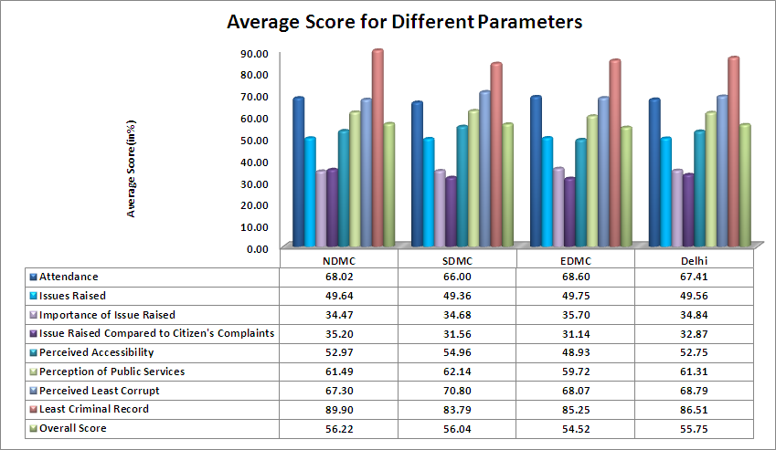

Slide 17
Top Councillors in Different Parameters across Delhi
Parameters | Top Councillors
Attendance | 100%: Seema Taihra, NDMC (Area: Bazar Sita Ram); Lata Sodhi, NDMC (Area: Ram Nagar)
Number of Issues Raised | 809 issues raised: Mohan Prasad Bhardwaj, NDMC (Area: Bankner)
Importance of Issue Raised | 47%: Anil Gautam, EDMC (Area: Durga Puri)
Issue Raised Compared to Citizen's Complaints | 61%: Niki Singh, EDMC (Area: New Ashok Nagar)
Perceived Accessibility | 92%: Varyam Kaur, EDMC (Area: Raghubarpura)
Perception of Public Services | 89%: Radhey Shyam Sharma SDMC (Area: Vasant Vihar)
Perceived Least Corrupt | 94%: Maya Devi, SDMC (Area: Manglapuri)
Overall Score | 72%: Rajni Mamtani, SDMC (Area: Janak Puri South)

Slide 18
THANK YOU!!!

